Slide 1

UNIX PROJECT
TOPIC:-
SNAKE’S AND LADDER’S GAME
GROUP MEMBER’S:-
1.VENKATESH B.H
2.RASHAD AHMED
3.VISHAL NIRNEY
4.NITEESH KUMAR

Slide 2
What is Snake-Ladder game ?
Snakes and Ladders is an ancient Indian board game regarded today as a worldwide classic. It is played between two or more players on a gameboard having numbered, gridded squares. A number o “LADDERS” and “SNAKES” are pictured on the board, each connecting two specific board squares.
The object of the game is to navigate one’s game piece, according to die rolls, from the start (bottom square) to the finish (top square), helped or hindered by ladders and snakes respectively.

Slide 3
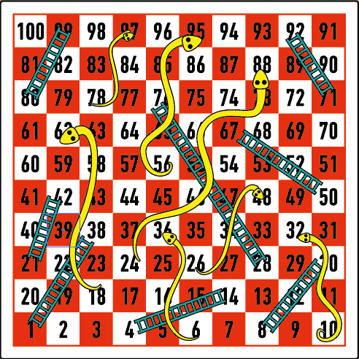
GAME DESCRIPTION

Slide 4
Features of the game !!
Game Rules.
Single Player Mode.
Multiplayer Mode (DOUBLE).

Slide 5


GAME RULES:-
The rules are simple:
You press ‘r’ to roll the die.
You are then told which space you have landed on.
If you land on a snake you will move down the board.
If you land on a ladder then you will move up it.
In order to win you must land on 100 exactly.
If you go over 100 then your game piece will be unmoved.
Press 'q' or 'Q' and then press 'y' or 'Y' to Quit.
Note: If you don't want to quit after pressing 'q' or 'Q' then you can press any key.
**Good Luck**

Slide 6
OUTCOME OF THE PROFECT !!
My project has some awesome outcomes. It can
Helps in Logic Development.
Helps FRESH of mind to us.
Entertain Us.

Slide 7

THANK YOU

